Slide 1
Cellular Automata
A Stepping Off Point

Slide 2
A Cellular Automaton Is a System with:
A notion of discrete time t = 0, 1, … that ticks along
A (possibly infinite) set of “cells” each of which has
One of a finite number of “states” at a given time
A (possibly ordered) subset of other cells that constitute its “neighborhood”
A rule that gives the state of the cell for t = n + 1 based on
The state of the cell at t = n and on
The state of the cells in its neighborhood at t = n
Typically
Time is the same for all cells
Cells are arranged in a rectangular grid with a finite number of dimensions
A cell’s neighborhood is defined as a function of the cell’s position in the grid
The function defining a cell’s neighborhood is the same for all cells
The rule for updating a cell is the same for all cells and does not vary with time

Slide 3
Example: Elementary CA “Rule 30”
Cells
Have 2 states, 0 and 1
Form a 1D infinite rectangular grid
Have two neighbors, left and right
Evolve according to the rule:
Current state of cell and neighbors | 111 | 110 | 101 | 100 | 011 | 010 | 001 | 000
New state of center cell | 0 | 0 | 0 | 1 | 1 | 1 | 1 | 0
0b00011110 = 0x1E = 30
Hence: “Rule 30”

Slide 4
Elementary CA “Rule 30:” One Clock Tick
By Cormullion - Own work, CC BY-SA 4.0, https://commons.wikimedia.org/w/index.php?curid=74536115

Slide 5
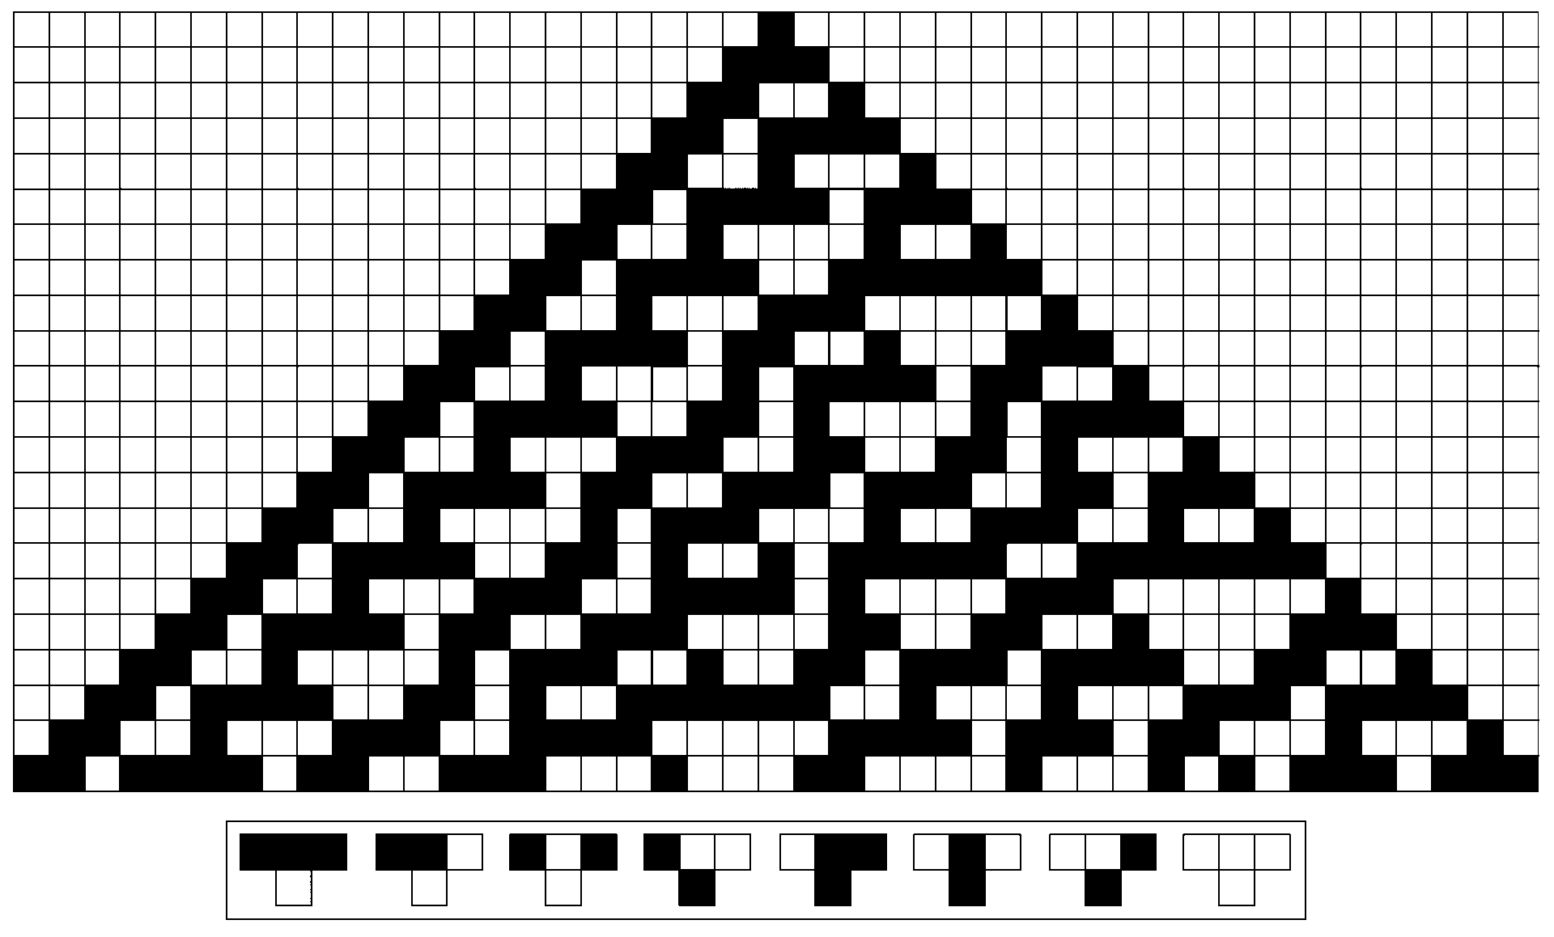
Elementary CA Example: Evolution Over Time
t
Based on Nonenmac at English Wikipedia, CC BY-SA 3.0, https://commons.wikimedia.org/w/index.php?curid=97530413

Slide 6
Elementary CA Example: Evolution Over Time
Let’s try it:
https://devinacker.github.io/celldemo/

Slide 7
CA History (per Wikipedia)
Discovered in the 1940s by Stanislaw Ulam and John von Neumann while at Los Alamos National Laboratory
CAs studied academically in connection with “symbolic dynamics” in the 60s
In particular, Gustav Hedlund’s seminal paper in 1969
In 1970 John Conway’s “Game of Life” brought CAs an audience
Popularized by Martin Gardener in Scientific American article
Stephen Wolfram systematically studied one-dimensional CAs in the 80s
In 1990 Matthew Cook showed that one of these (Rule 110) is Turing-complete

Slide 8
CA Behavior Classification (per Wolfram)
Nearly all initial patterns evolve:
Class 1: Quickly into a stable, homogeneous state.
Class 2: Quickly into stable or oscillating structures
Class 3: In a pseudo-random or chaotic manner
Class 4: Into structures that interact in complex and interesting ways, forming local structures that are able to survive for long periods of time

Slide 9
The Most Famous CA: Conway’s Game of Life
Cells
Have 2 states, 0 and 1 – “dead” and “alive”
Form a 2D infinite rectangular grid
Have eight neighbors – the surrounding cells including the diagonals
Evolve according to the rule:
Any live cell with fewer than two live neighbours dies, as if caused by underpopulation.
Any live cell with two or three live neighbours lives on to the next generation.
Any live cell with more than three live neighbours dies, as if by overpopulation.
Any dead cell with exactly three live neighbours becomes a live cell, as if by reproduction.

Slide 10
Conway’s Game of Life
Turing Complete
Endlessly fascinating
Let’s play with it!
https://playgameoflife.com/
Bill Gosper's Glider Gun
Image made using Life32 v2.15 beta, by Johan G. Bontes
Creative Commons Attribution-Share Alike 3.0 Unported license

